Slide 1
WELCOME!
Scripture taken from the New King James Version®.
Copyright © 1982 by Thomas Nelson. Used by permission. All rights reserved.

Slide 2

Answering Arguments for General Benevolence from the Church’s Treasury
General Benevolence and the Church’s Treasury?
Notes:
This lesson follows two sermons on “Pride and Benevolence” and “Pride and Divine Limitations.”

Slide 3
Whatever the
INDIVIDUAL CHRISTIAN
can do is what
THE CHURCH CAN DO!

Slide 4
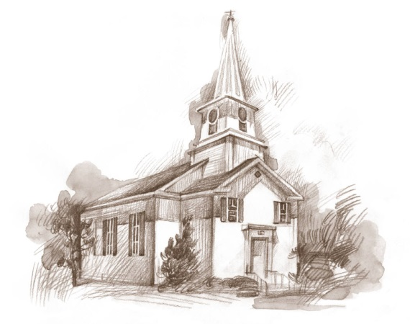

The Individual Christian
The Church
May Observe A Day
Rom. 14:5, 6
Not permitted to observe days
(Gal. 4:10, 11)?
Colossians 3:17

Slide 5
The Individual Christian
The Church
May Lend To One Who Asks
Matt. 5:42;
Lk. 6:34, 35
Where does the Bible permit the church to lend to anyone?
Colossians 3:17

Slide 6

TWO DISTINCT TREASURIES
THE
CHURCH
INDIVIDUAL
CHURCH
Method of Raising
Honest Labor
(Eph. 4:28)
Voluntary Offering
(1 Cor. 16:1, 2)
Oversight
Self (Acts 5:3, 4)
Elders (Acts 11:30)
Use
Contribution
(2 Cor. 9:7)
Taxes (Rom. 13:6, 7)
Domestic (1 Tim. 5:8)
Sharing
(1 Tim. 6:18; Gal. 6:10)
Preaching Gospel (Phil. 4:15, 16)
Relieving Needy Saints
(Acts 4:32-34)
Notes:
Oversight, elders consider also Titus 1:7

Slide 7
THREE DISTINCTIONS
Matthew 18:15-18
15 "Moreover if your brother sins against you, go and tell him his fault between you and him alone. If he hears you, you have gained your brother.
16 "But if he will not hear, take with you one or two more, that ‘by the mouth of two or three witnesses every word may be established.’
17 "And if he refuses to hear them, tell it to the church. But if he refuses even to hear the church, let him be to you like a heathen and a tax collector.
Church Cannot Act Here!
THE CHURCH!
Notes:
You could technically have a 2 or 3 man church, but just because there are 3 people of the same church doing something, it does not necessarily constitute the action of the church.

Slide 8
It doesn’t say,
“NOT TO”

Slide 9
1 Corinthians 4:6 (New International Version)
“Now, brothers and sisters, I have applied these things to myself and Apollos for your benefit, so that you may learn from us the meaning of the saying, ‘Do not go beyond what is written.’ Then you will not be puffed up in being a follower of one of us over against the other.”

Slide 10
IMPLICATIONS FROM SPECIFIC TEACHING
COMMAND | IMPLICATION
GOPHERWOOD FOR ARK Gen. 6:14 | NO OTHER KIND OF WOOD
LEVITES AS PRIESTS Deut. 10:8 | NO OTHER TRIBE Heb. 7:12-14
CHURCH RELIEVE REAL WIDOWS 1 Tim. 5:16 | NO OTHER WIDOW

Slide 11
The “Like God”
Argument

Slide 12
MATTHEW 5:43-48, argument goes…
Is God benevolent?
Is God benevolent to the just?
Is God benevolent to the unjust?
Are Christians to be benevolent to the just and unjust?
Is the church benevolent to the just?
Is the church benevolent to the unjust?
Is The Church To Be Like God?

Slide 13
MATTHEW 5:43-48
Is speaking to individual disciples, not churches (as is Gal. 6:10; Jas. 1:26, 27)
An evidence of sonship (cf. Lk. 6:34, 35)
Why not also argue for general celibacy?
  Was Jesus married on earth?
  Are we to be like Jesus (1 Cor. 11:1)?

Slide 14
“ALL MEN”
Argument
2 Corinthians 9:13

Slide 15
“All” Defined By CONTEXT
COMPARE: 1 Timothy 5:20, “Those who are sinning rebuke in the presence of all, that the rest also may fear.”

Slide 16
2 Corinthians 9:13 in CONTEXT
“…the gift and the fellowship of the ministering to the saints” (8:4)
“…that there may be equality” (8:14)
“…the ministering to the saints…” (9:1)
“…supplies the needs of the saints…” (9:12)
“…they glorify God for the obedience of your confession to the gospel…” (9:13)
“and by their prayer for you, who long for you…” (9:14)

Slide 17

The Consistent Pattern
Scripture | Who Is Helped? |  | Who Helped Them?
 | Christians | Non-Christians | Local Church | Benevolent Institution
Acts 2:44-45
Acts 4:32-35
Acts 6:1-6
Acts 11:27-30
Rom. 15:22-29
1 Cor. 16:1-4
2 Cor. 8, 9
1 Tim. 3:5-16

Slide 18
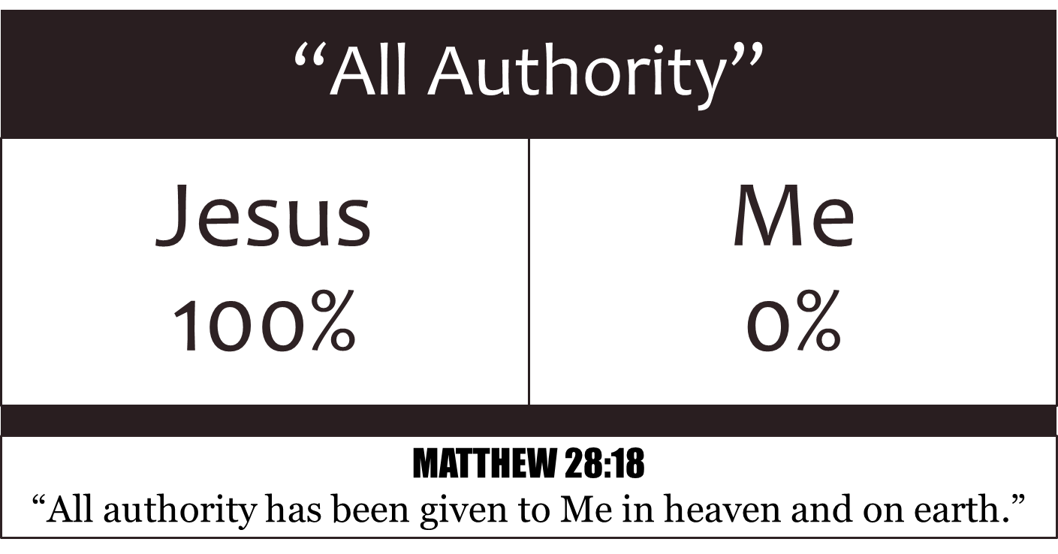
“LIMITED”
BENEVOLENCE

